Slide 1
SETMIS- The Skills Education and Training Management Information System

Slide 2
Background
National Delivery Agreement 5 Outcome; namely: “A Skilled and Capable Workforce to Support an Inclusive Growth Path” includes a particular reference to the strategic goal of developing “a credible institutional mechanism for skills planning” as articulated in Goal 1 of the National Skills Development Strategy III and Output 1 of Outcome 5.
Output 4.1.1.1 of the National Skills Development Strategy III, requires that “Capacity is established within the Department of Higher Education and Training to coordinate research and skills planning”.
As a result, the DHET is improving the current SETA Quarterly Monitoring Report format through an automated system which uses unit record, batch file data collection process which will feed data from the SETA’s Indicium into the Skills Education and Training Management Information System (SETMIS).

Slide 3
What is this SETMIS
SETMIS is a data warehouse that acts as a feeder management information system to HETMIS.
The overall objective of HETMIS, and as a result SETMIS, is to create a credible, integrated and unified view of the skills supply side in the country to improve skills planning to meet the needs of an inclusive growth path for the country.

Slide 4
Expectations
Data quality is of paramount importance as data gets used for decision making and for planning purposes.
At all times, Stakeholders and the SETAs are to ensure that data submitted to SETMIS is quality assured and complete.
On a regular basis, DHET conducts its own data quality assurance and alerts SETAs on discrepancies found for correction and/or resubmission of “ERRORS”.
For reporting purposes, data analysis is conducted hence the accuracy of data submission / capturing is significantly critical to the SETA i.e., learners funded in the quarter or financial year to be reported as such.

Slide 5
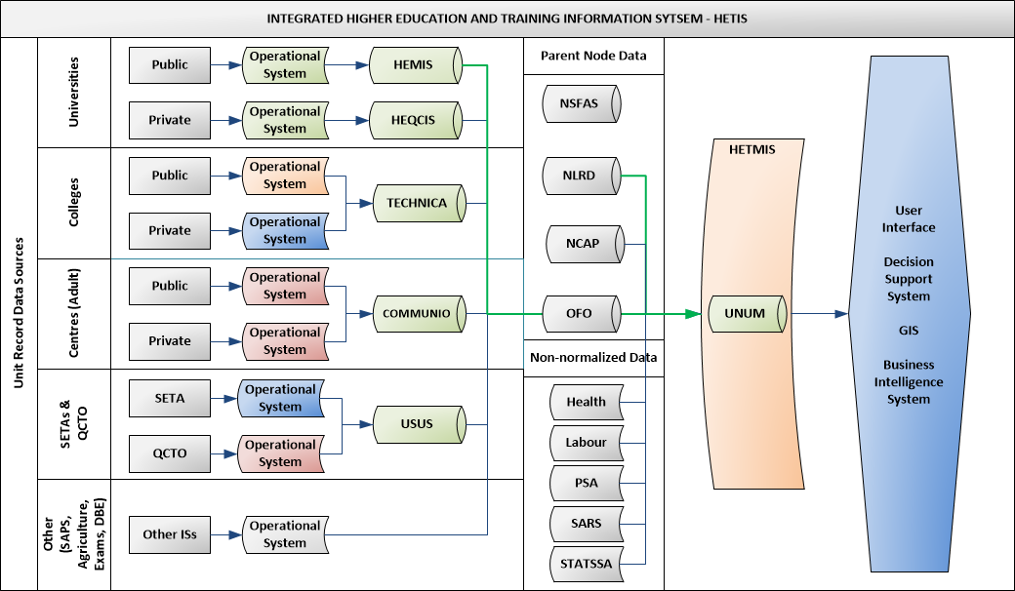
The Aim of SETMIS from DHET perspective

Slide 6
SETMIS Process
SETMIS data collection and submission process:
Indicium feeding based on stakeholder data;
SETAs data extraction module for transmission
SETAs data validation and transmission
EDUktiV validation and submission utility
DHET data loading procedure
DHET SETMIS day-to-day management:
Data submission feedback reports
Data quality and analysis
Data submission declaration processing

Slide 7
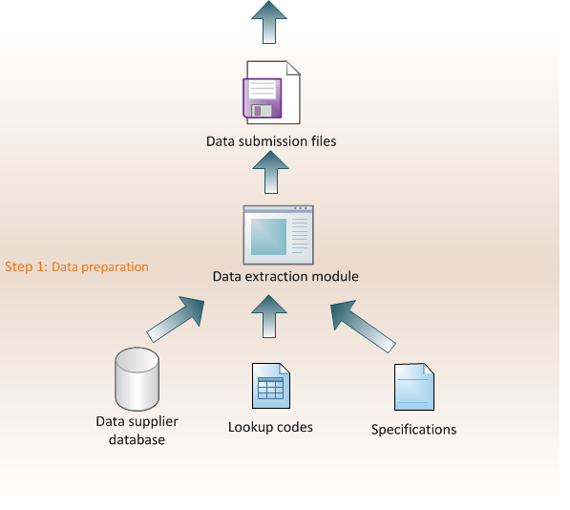
How is SETMIS build…..

Slide 8
How is SETA responsible, what is required from Stakeholders
Information is reported quarterly, within the financial year (2020-2021 and for 2021-22)
Providers, Employers and other DG recipients:
Information and learner registration must be captured in the correct quarter as per the start date or end date of the programme.
The quarters are as follows:
Q1 – April, May and June (Quarter already passed)
Q2 – July, August and September (Last date of entering data by Stakeholder – 30 September 2020)
Q3 – October, November and December (Last date of entering data by Stakeholder – 31 December 2020)
Q4 – January, February and March (Last date of entering data by Stakeholder – 31 March 2021)

Slide 9
How is the SETA responsible, what is required from Stakeholders
The Stakeholders should be aware that all data fields are now compulsory and must be completed on indicium when capturing learner data;
Spelling of Names and Surnames, Titles of Qualifications must be correct.
ID Numbers must be checked for accuracy (Deceased).
The first letter of every new word must be in capital – do not type entire words in capital letters (Case sensitive).
Stakeholders to upload clearly certified copies of ID, and qualification Certificates (Please separate these documents, do not upload all documents as IDs this causes confusion).
GPS co-ordinates must be accurately captured (system illustration).
All supporting evidence and signed learner agreements as per learners captured must be emailed to Regional Office.

Slide 10
Thank you

